Slide 1



Analysing Students’ Feedback (BPAS) to improve course delivery and class experience for the students
G2 Group 4 Team Members:
Tan Wei Long, Ryan
Ong De Lin
Narang Aakshi
Lee Jia Ern Janell
Lau Jun Rong
Benedict Then Ji Xiang

Slide 2



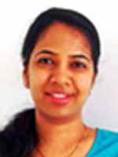
Motivation
Improving the way courses are structured and delivered in the Education domain
Assisting the Faculty to improve course structure and delivery
Improve Course Experience for students taking the course

Slide 3

Business Scenario
Selected Business Process & Current Issues
Task 1 (Topic Modelling)
Identify common challenging and popular aspects that contributed to their class learning experience.
Task 2 (Predictive Classifier)
Identify potentially weaker students that might require extra assistance by predicting their assignment grades from their feedback.
Notes:
Identify common challenging concepts for students as well as popular aspects that contributed to an enjoyable and constructive learning experience for them (Task 1)
The faculty have to go through many feedback forms each week in order to extract out these details which is a time consuming and tedious process.
Additionally, these feedbacks can be phrased differently but mean the same thing, which makes it harder for the faculty to process them
Be able to identify students that might need extra assistance from the faculty through predicting their assignment grades for a particular topic (Task 2)
There are many factors that contribute to a student’s learning experience which ultimately determines their grades. However, it is not clear which factors are more important and if they can be obtained from the feedback provided by the students

Slide 4
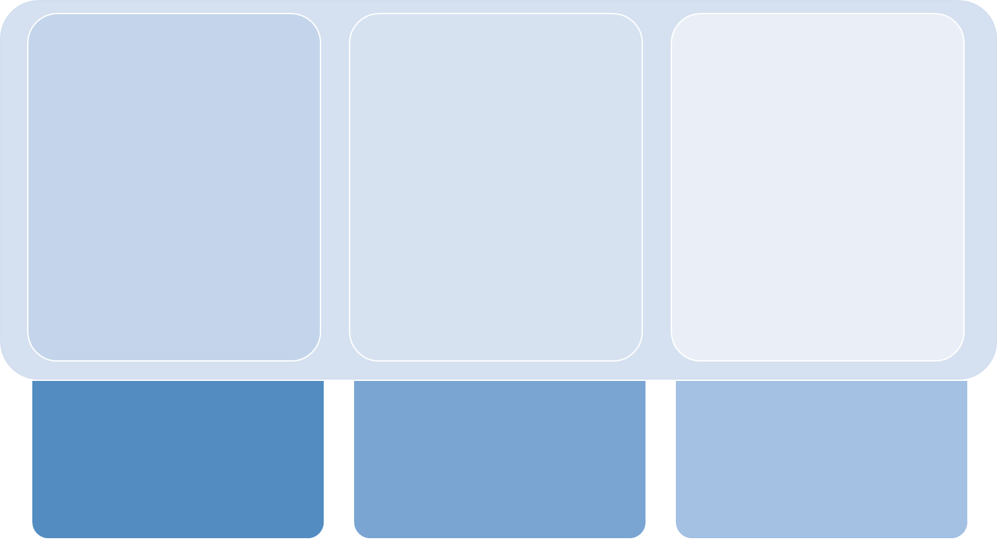



Dataset used
Students’ Feedback
Students’ Grades
BPAS Course Outline
Notes:
3 datasets: Feedback.csv, Grades.csv, BPAS topic outline

Slide 5
Dataset used
Dataset Columns
Timestamp
Student_ID
Class section
“List one topic of the class that you enjoy”
“What was the most challenging topic of the class?”
“(Optional) What do you suggest to improve the class?”
Exam score
Notes:
3 datasets: Feedback.csv, Grades.csv, BPAS topic outline

Slide 6
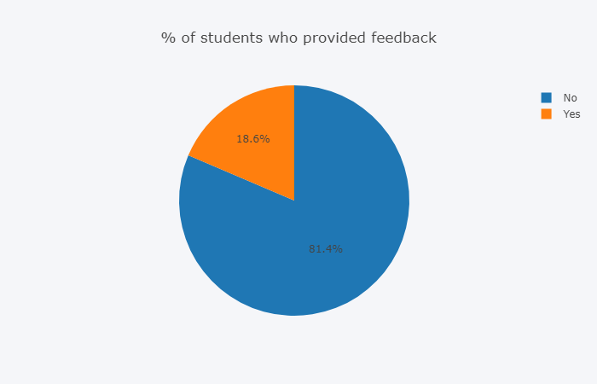
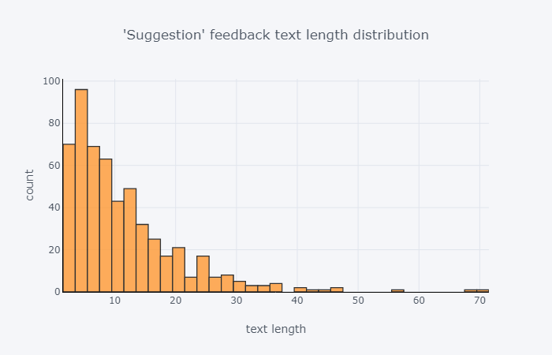

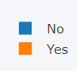
EDA
576
2523
3,000+ feedbacks from 373 students.
Out of 3,000+ feedback, only 18.6% provided feedback in the suggestion column.
Average feedback length 0 - 15 words

Slide 7
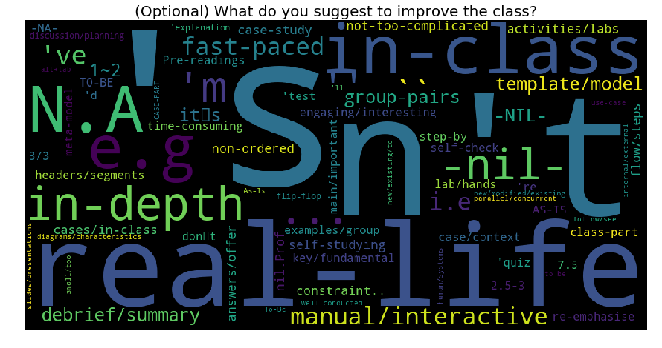
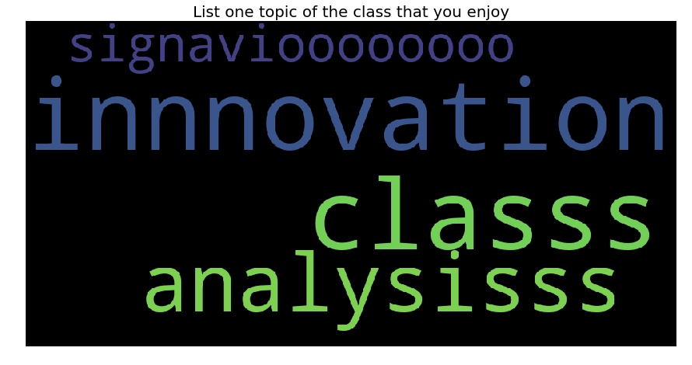
EDA
Expand contractions
Correct repeated consecutive characters in words

Slide 8
Data Preprocessing
Standard Preprocessing steps:
Lowercase words
Removal of stopwords
Removal of punctuation/symbols
Removal of digits
Lemmatization
Removal of short words (1 letter words)
Specific Preprocessing steps for our dataset:
Removal of null feedbacks
Removal of consecutive words
Normalization of words
Expand Contractions
[“nil”, “None”, “Nothing as of now”]
[“signaviooooo”, “classss”, “analysisssss” ]
{“prof”: “professor”, “ty”: “thank you”, “qn/qns”: “question”}
[“I’ll: I will”, “cause: because”, “don’t: do not”]

Slide 9
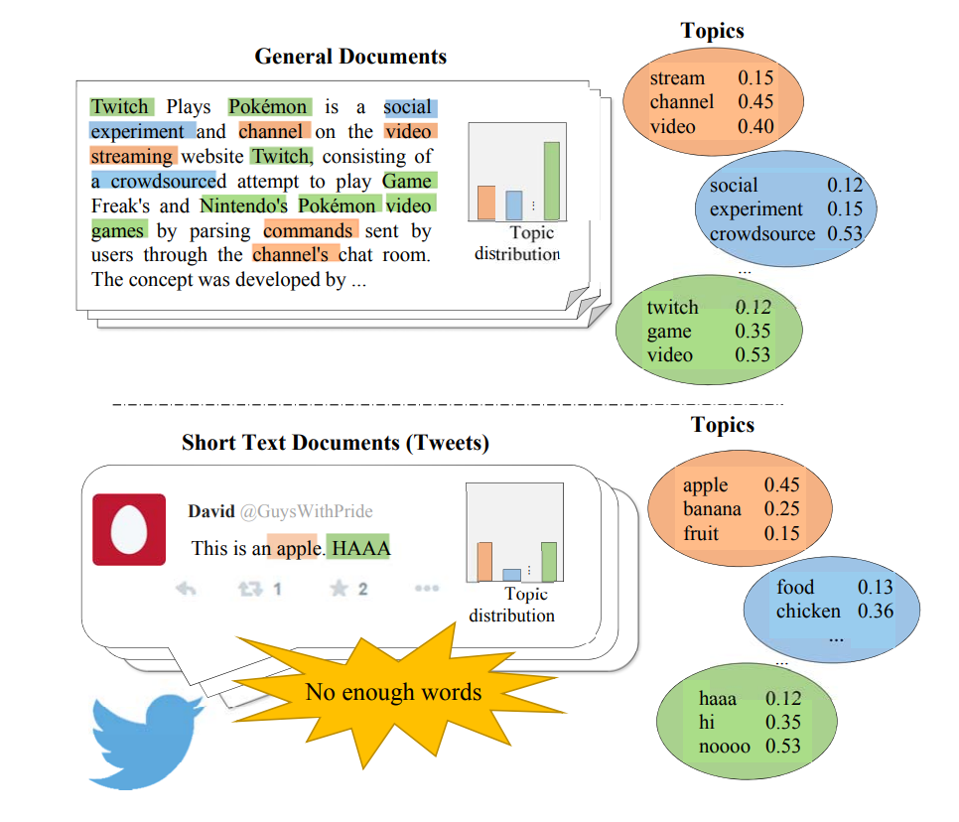

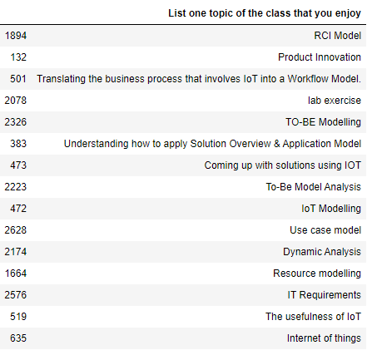
Data Challenges
Short Text
Single topic per document
Linguistic Features
Documents have ~5 words
Word sparsity issue
576 records for “Suggestion” column.
Only one topic per document
Violates LDA’s assumption
Nature of feedback
Lack the linguistic features present in full documents such as word collocations.
Informal structure of sentences

Slide 10
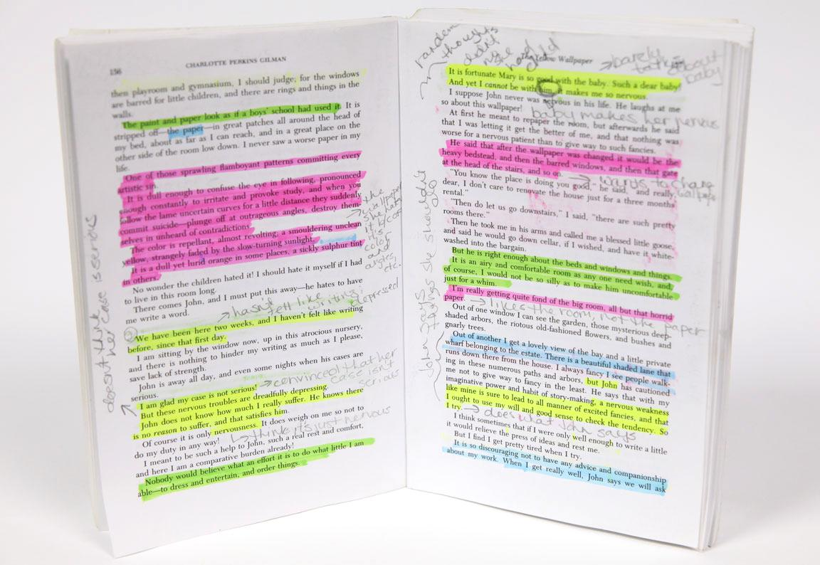



Task 1
Topic Modelling & Keywords Extraction
Perform topic modelling feedback columns:
Assigning labels to topics automatically based on the similarity of words
Used in task 2
“Enjoyed Topic”
“Challenging Topic”
“Suggestions”

Slide 11


Task 1
How is this relevant in the decision making process?
Identified challenging topics for students
Identified enjoyable topics for students
Assist the faculty to revise particular concepts that were challenging or change their delivery methods
Students get a better grasp on the concepts covered.
Identify Student’s potential areas of interest so that faculty can tailor activities/discussions to incentivize students to participate.

Slide 12
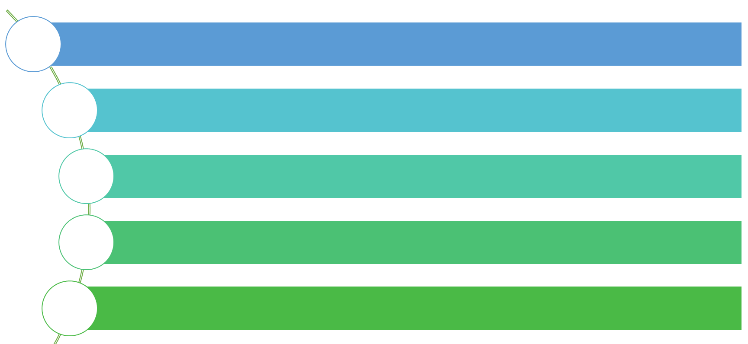
Task 1
Solution Methodology
Baseline model (LDA) to compare performance across different approaches
3 Different Approaches taken - Modifying our baseline at the Data-level and Model-level
Standardized parameters for each approach - random starting seed, number of iterations and number of topics
Qualitative and Quantitative evaluation
Determine best approach

Slide 13
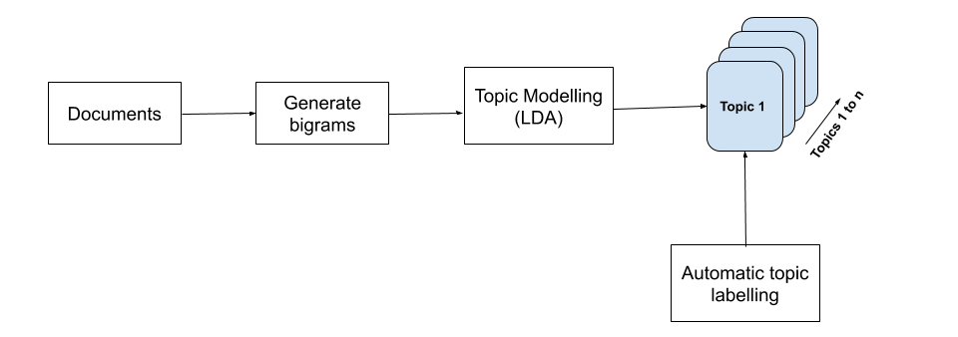
Task 1
Baseline approach (LDA)
Notes:
here we determined using bigrams were better → after running one with and one without, as many of the terms are bigrams like root_cause, solution_overview etc.

Slide 14
Task 1
Literature Review
Topic Modeling over Short Texts by Incorporating Word Embeddings (Qiang et al, 2017)
Proposed Embedding-Based Topic Modelling (ETM)
Train word embeddings from a large corpus
Cluster to form larger documents
Coherence Measure scores on the ETM averaged 72.5%

Slide 15
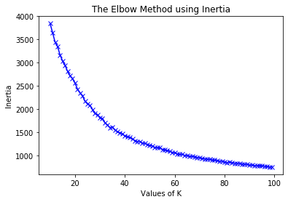
Task 1
Data Level approach
(Aggregating documents by vector space similarity)
Convert to word embeddings using transferred learning
Google’s pre-trained model on Google News Dataset
Infer each word in our document
Represent our documents by averaging out the word vectors
Cluster our documents - K-means clustering
Reduce features as K-means work better in lower dimensions
PCA transformation (100 to 30 features, retaining 68% of variability)
No clear k to choose
No distinguishable features in our embeddings
Slight elbow at K=20
Similar to number of topics
Documents of same cluster joined to form a pseudo-document

Slide 16
Task 1
Literature Review
Improving LDA Topic Models for Microblogs via Tweet Pooling and Automatic Labeling (Mehrotra et al, 2013)
Author-wise pooling
One document per author (aggregate all the author’s tweets)
Hashtag-based pooling
Each hashtag will talk about a central theme
Achieved High purity scores of 0.54 compared to baseline (unpooled) of 0.49

Slide 17
Task 1
Data Level approach
(Aggregating documents by weeks)
Aggregate our documents by the week of feedback submitted
Ensure each document has similar content and nature
Feedback submitted is pertaining to that week of class
10 documents in total
Passed as input to LDA

Slide 18
Task 1
Literature Review
A Dirichlet Multinomial Mixture Model-based Approach for Short Text Clustering (Yin & Wang, 2014)
Assumption of one latent topic per document
Movie group process analogy
Students have list of favourite movies
Students assigned to tables:
more students than current table
table with students of similar list of movies
Eventually reach optimal configuration
Better homogeneity and completeness than K-means (0.853 and 0.896 compared to 0.692 and 0.775)

Slide 19
Model level approach
(Gibbs sampling Dirichlet Multinomial Mixtures - GSDMM)
Task 1
Keep data the same (no aggregation) but feed to GSDMM instead of LDA
The parameter: β
When β increases, the number of clusters found decreases and we will result in a less homogeneous cluster and higher completeness
Homogeneity is important to us because of how our topic labelling algorithm works
More words in same chapter results in a correct label prediction
Set β to be a lower value than the default (0.1), at β=0.05

Slide 20
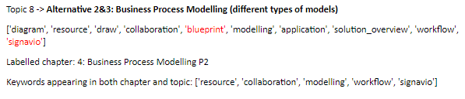
Task 1
Automatic topic labelling
Use of a gazette to help us automatically assign a topic label
Created from the module outline of syllabus
Keywords are unique and defines each chapter
Fuzzy string matching to get similarity
Automatic Topic Labelling based on predefined dictionary

Slide 21
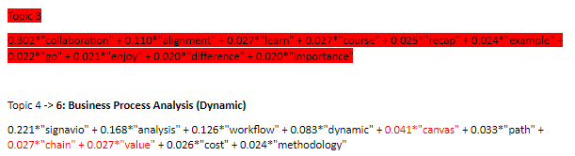
Task 1
Findings, insights & analysis
Evaluation Method Used (Qualitative):
Manually label each topic generated based on our gazette
Determine if topic is coherent or not
Determine if there are incoherent words within the identified Topic
Incoherent Topic
Identified Topic
Identified Noise

Slide 22

Task 1
Findings, insights & analysis
Evaluation Method Used (Quantitative):
From Manually Labelled Topics for each model:
Count number of incoherent topics
Calculate average purity of topics:
Out of coherent topics, how many words were coherent?

Slide 23
Task 1
Findings, insights & analysis
Score | Baseline (unigram) | Baseline (bigram) | Aggregation - vector similarity | Aggregation - academic weeks | GSDMM
Average Topic Purity Score | 0.87143 | 0.9 | 0.8 | 0.9125 | 0.92222
Incoherent Topics | 3 | 2 | 2 | 2 | 1
GSDMM appears to be the best performing method as it has the least number of incoherent topics and out of the topics, it has the highest average topic purity score as well.

Slide 24
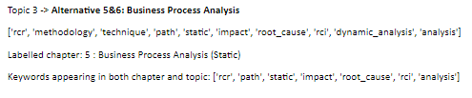
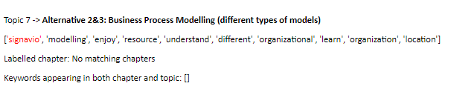
Task 1
Discussions and Gap Analysis - What went well?
Generally all the topics obtained were coherent, with minimal amount of noise in each topic.

Slide 25
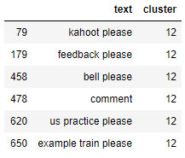
Task 1
Discussions and Gap Analysis - What didn’t go well?
Aggregation on vector space similarity
Incoherent clusters due quality of word embeddings

Slide 26

Task 1
Future work
Recommender systems to supplement current topic model output
Currently, only dominant topics that may need attention are detected
Does not show underlying reasons as to why it is the case
e.g. why they find it challenging, or foundational topics that they are weak in
Notes:
To bring it back to our scenario where we are looking at the “challenging” column, it only shows the dominant topics but not the underlying reasons as to why these students felt it was challenging

Slide 27
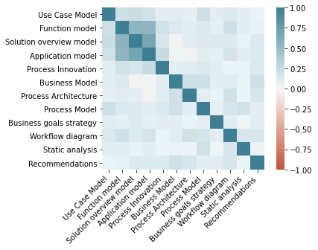
Task 1
Future work
Create Correlation Matrix of the component grades pertaining to each chapter
Implement in the form of recommender system
Recommend highly related topics that the teaching team can examine when the dominant topic input is passed in

Slide 28

Task 2
Building a classifier to Predict Students’ Grades using Students’ Feedback

Slide 29
Task 2
How is this relevant in the decision making process?
Class Learning Experience
The objective: Evaluate the correlation between students’ class learning experience and their grades. Determined by feedback. (words used, feedback sentiment, frequency etc)
The purpose:
Help faculties identify potentially weaker students earlier who may require extra assistance in the course.
Link?
Grades
Notes:
The objective of task 2 is to evaluate the correlation between students’ class learning experience and their grades. A student’s class learning experience can be determined by his/her weekly feedback provided. For example, the words they are using, the frequency of their feedback and the sentiment of their feedback etc. Hence, we built a classifier that aims to predict a student’s grade based on the characteristics of their feedback.
The purpose of this task is to help faculties identify poor performing students who may potentially require extra assistance in the course. The ability to do so can allow faculties to intervene and help those in need sooner. Furthermore, it also helps the faculties understand what are the possible factors that lead to a student having a good or bad class learning experience.

Slide 30
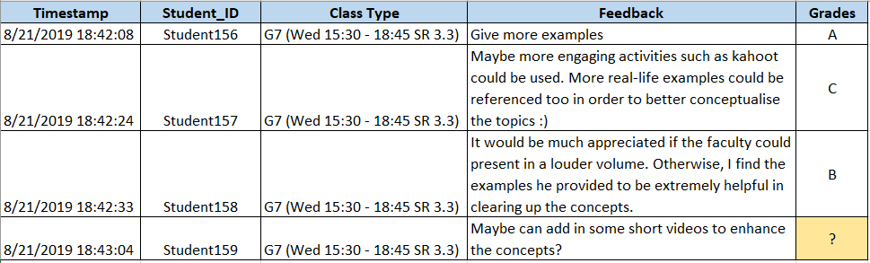
Task 2
Target Variable

Slide 31
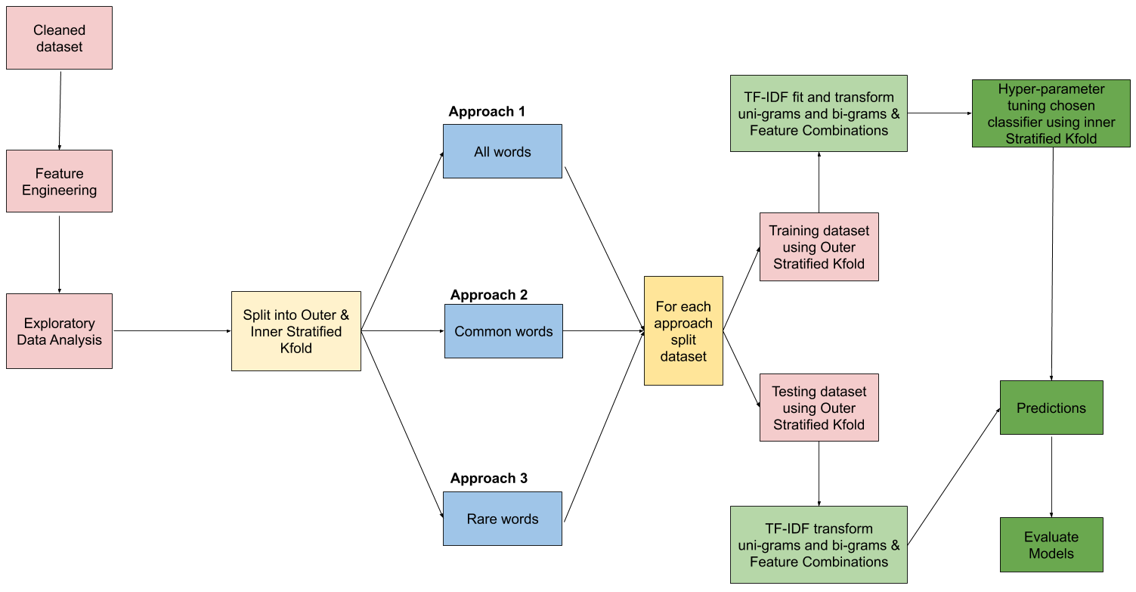
Task 2
Solution Methodology
Notes:
After evaluating and choosing our classifier, we conducted our classification model based on 3 approaches with all the possible combinations of features engineered (including modelling with just the words alone). The first approach leveraged on all the words mentioned by the students. The second approach only used words which were mentioned by students which is higher than the median word count of the training dataset. The last approach only used words which were mentioned by students which is lesser than or equals to the median word count of the training dataset. The first approach is mainly used as a baseline approach for our methodology. The second and last approach is to see if the model predicts better with a dense or a sparse matrix of words.

Slide 32
Task 2
Feature Engineering
Feature Engineering
We did feature engineering to create new features to aid in our predictive models.
7 new features were created from the existing features in our dataset
Grades
Sentiment score
Feedback length proportion
Frequency of suggestion
Class type
Fuzzy similarity scores
Topic modelling

Slide 33
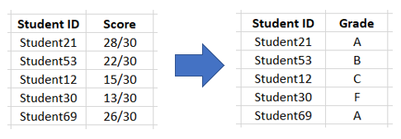
Task 2
Feature Engineering
(1. Grades)
Converted numeric scores into categorical variables to train our classifier. SMU’s grading system (A, B, C, D & F).

Slide 34
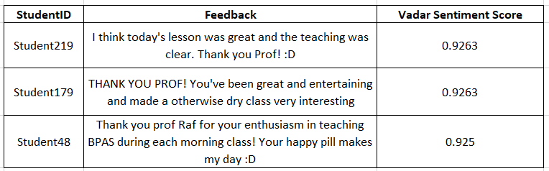
Task 2
Feature Engineering
(2. Feedback Sentiment Score)
Vadar Sentiment Analyzer to calculate the polarity score for each student before fitting it into our predictive model

Slide 35
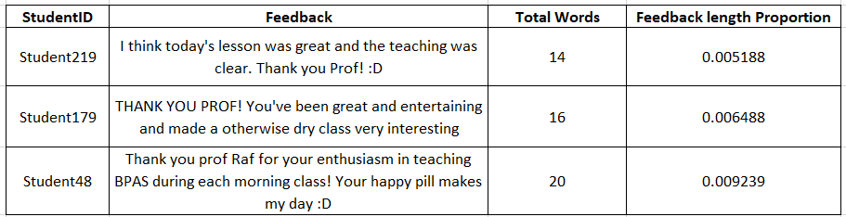
Task 2
Feature Engineering
(3/4. Frequency and Length of Feedback)
Frequency of feedback refers to how frequent each student provides feedback within the 13 weeks.
Feedback length proportion refers to the total number of words provided by each student, divided by the total num of words by all students (Standardization)
Notes:
refers to the total number of words provided by each student (after text cleaning). In order to standardized the score, we divided it by the total number of words provided by all students (after text cleaning).

Slide 36
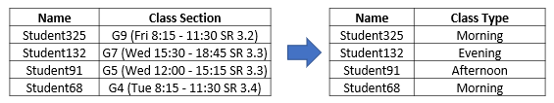
Task 2
Feature Engineering
(5. Class Type)
Class Type refers to the students attending either morning, afternoon or evening class. [8:15am, 12pm, 3:30pm]

Slide 37
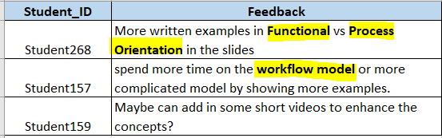
Task 2
Feature Engineering
(6. Fuzzy Similarity)
Gazette (BPAS terms)
Fuzzy Similarity refers to how similar the feedback is with regards to the teaching materials or components of the assignment grades.
(Does specificity matter?)
Notes:
Fuzzy Similarity refers to how similar the feedback provided with the teaching materials or components of the assignment grades. We formulated the teaching materials or components into a gazette. We used the ratio algorithm of the fuzzy matching where we matched the Feedback with the words in the gazette.

Slide 38
Task 2
Summary of Features
Before
Suggestion Feedback
Total Score (Target)
After
Suggestion Feedback
Sentiment score*
Feedback length proportion
Frequency of suggestion
Class type
Fuzzy similarity scores *
Topic modelling
Grades (Target)
* - uses “Enjoyed Topics”, “Challenging Topic” & “Suggestions”
Notes:
Fuzzy Similarity refers to how similar the feedback provided with the teaching materials or components of the assignment grades. We formulated the teaching materials or components into a gazette. We used the ratio algorithm of the fuzzy matching where we matched the Feedback with the words in the gazette.

Slide 39
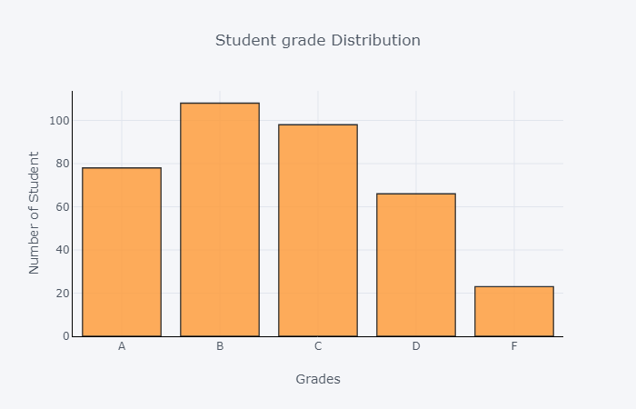
Task 2
Evaluation Metrics
Evaluation Metrics | Reasons | Rank
F1 Macro | Not bias against imbalanced dataset Does not equally treat classes and simply aggregating the individual F1 Scores for each classes | 1
F1 Weighted | Favour majority classes (Grade A,B & C) Calculates the F1 score for each class independently but adds them together using a weight that depends on the number of true labels of each class. | 2

Slide 40
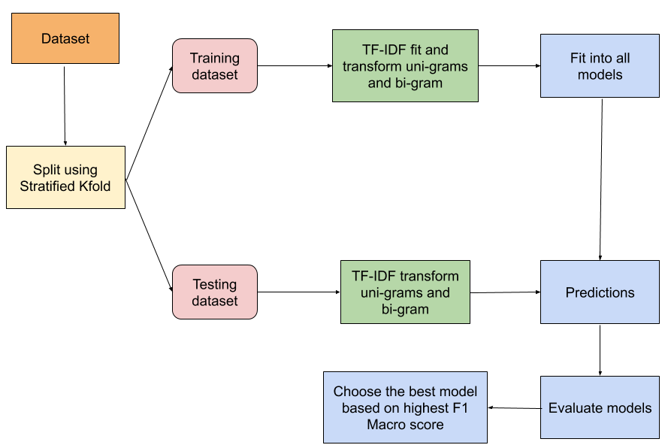
Task 2
Methodology to Choose Base Classifier
Notes:
After evaluating and choosing our classifier, we conducted our classification model based on 3 approaches with all the possible combinations of features engineered (including modelling with just the words alone). The first approach leveraged on all the words mentioned by the students. The second approach only used words which were mentioned by students which is higher than the median word count of the training dataset. The last approach only used words which were mentioned by students which is lesser than or equals to the median word count of the training dataset. The first approach is mainly used as a baseline approach for our methodology. The second and last approach is to see if the model predicts better with a dense or a sparse matrix of words.

Slide 41
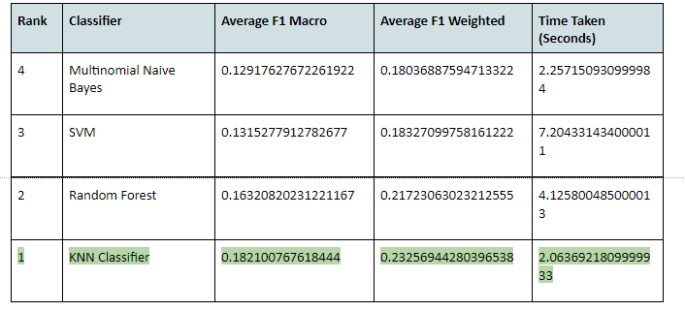
Task 2
Results from Base Classifier
Based on uncleaned text and untuned models.
Notes:
The table above shows the results of the classifiers. We can observe that the best classifier is the KNN Classifier, followed by Random Forest, SVM and Multinomial Naive Bayes. In addition, KNN Classifier also runs within 6 seconds. Therefore, we will be using KNN Classifier as our baseline model.
The reason why the results are as such could be because KNN classifier takes into consideration the influence and characteristic of the word features around each other while Naive Bayes assumes that the words are independent from each other. Hence, this might explain why KNN classifier is better for our dataset as it contains several word terminologies such as “As-is process”, “To be process”, “Use case model”, “business process model” and “solution blueprint model” etc.
As for the SVM and Random Forest, these 2 classifiers might not be a good to use as they are prone to overfitting especially when the dataset contains a large amount of features. Which in our case, we have over 1000 word features (Varghese, 2018).

Slide 42
Task 2
Methodology for Modelling
Notes:
After evaluating and choosing our classifier, we conducted our classification model based on 3 approaches with all the possible combinations of features engineered (including modelling with just the words alone). The first approach leveraged on all the words mentioned by the students. The second approach only used words which were mentioned by students which is higher than the median word count of the training dataset. The last approach only used words which were mentioned by students which is lesser than or equals to the median word count of the training dataset. The first approach is mainly used as a baseline approach for our methodology. The second and last approach is to see if the model predicts better with a dense or a sparse matrix of words.

Slide 43
Task 2
KNN Parameters
Parameters | Values
weights | uniform, distance
metric | euclidean, manhattan, minikowski
algorithm | auto, ball_tree, kd_tree,brute
List of parameters and values to tune the model using RandomizedSearchCV against F1_Macro
Notes:
Based on the F1 Macro score, the best model we have attained is from the initial approach where we included all words which were mentioned by the students. However, we believed that the best approach is actually the last approach where we only keep words that occur less than or equal to the median word count of the training dataset. Analysis of why we say so is covered under later.
Since the KNN classifier takes into consideration the influence and characteristic of the word features around each other, there is a need to find out which words are required and to be kept.However, if resource and time is of concern, the second approach is also decent as the run time is significantly faster and there are minor differences in the F1 Macro score.
Across all three approaches, Frequency of their suggestions, Fuzzy Similarity Scores between feedback & course and Topic Modelling are important features which contributed to the performance of our classifier. This proves that our assumptions about students who find topics which are challenging or enjoyable have an impact on their grades.

Slide 44
Task 2
Three Approaches for Modelling
Approach | Definition
All Words | All words mentioned by students
Common Words | Common words are words that occur more than the median word count of the training dataset
Rare Words | Rare words are words that occur less which is lesser than or equals to the median word count of the training dataset.
Reason: Around 6700 vocabularies, evaluate whether there are words which are adding noise to our model
Notes:
We would always used the feedback column but will do a factorial experiment with the other features. This will lead us to having 64 combinations.

Slide 45
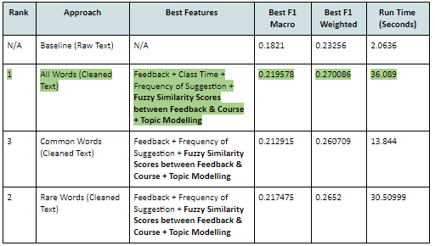
Task 2
Result Analysis (What worked well?)
Best Model based on F1 Macro: All Words Approach
Common Features that appears in all approaches:
Fuzzy similarity
Topic Modelling
Notes:
Based on the F1 Macro score, the best model we have attained is from the initial approach where we included all words which were mentioned by the students. However, we believed that the best approach is actually the last approach where we only keep words that occur less than or equal to the median word count of the training dataset. Analysis of why we say so is covered under later.
Since the KNN classifier takes into consideration the influence and characteristic of the word features around each other, there is a need to find out which words are required and to be kept.However, if resource and time is of concern, the second approach is also decent as the run time is significantly faster and there are minor differences in the F1 Macro score.
Across all three approaches, Frequency of their suggestions, Fuzzy Similarity Scores between feedback & course and Topic Modelling are important features which contributed to the performance of our classifier. This proves that our assumptions about students who find topics which are challenging or enjoyable have an impact on their grades.

Slide 46
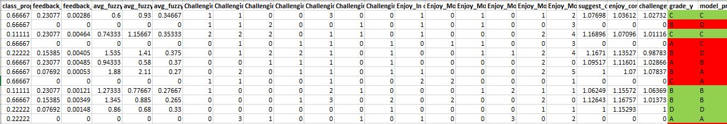
Task 2
Error Analysis (What didn’t work well?)
6 out of 12 students are misclassified.
Out of the 6 students, only 2 students were overestimated as strong-performing students.
Model is decent as it is not overestimating too many weak students as strong students.
Notes:
The table above shows a sample of the student’s actual grades and predicted grades from our final model with the last approach. In the second row, we can observe a student who has no similarity scores in their feedback & course was predicted to score a D but he/she has scored a B.
Out of the 12 samples shown above, we can see that it has misclassified half of them. However, the model only over-estimated 2 out of 6 misclassified students who are actually weaker students but were predicted to be stronger students. This is far better than misclassifying lots of weaker students than stronger students as we would not be able to help these weaker students earlier.

Slide 47
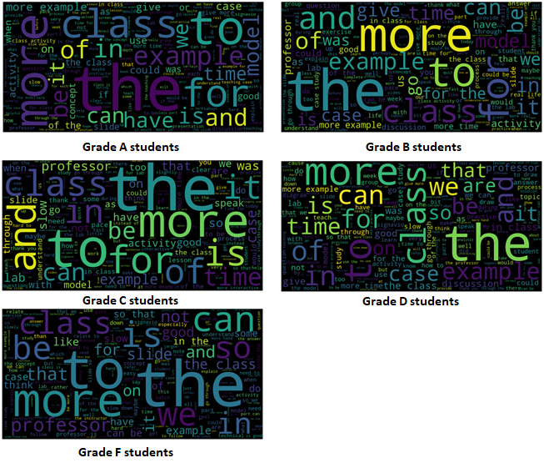
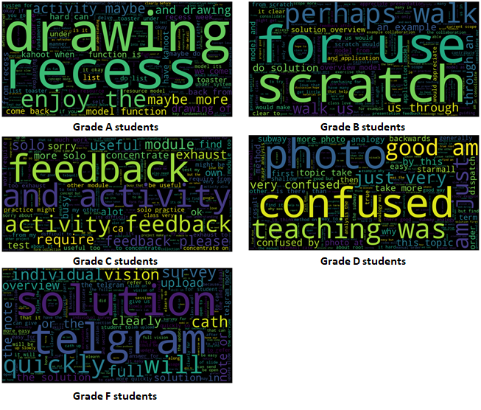
Task 2
Gap Analysis (What didn’t work well?)
All Words
VS
Rare Words
Notes:
From the above word cloud, we can observe that there are no distinctive or specific words used by different students across grades. In addition, there are a lot of common words between each student. For example, ‘class’, ‘more’, for’ and ‘example’. This might be noise in our data which could contribute to the misclassification of some grades. Therefore, to rectify this issue, we excluded commonly used words and generated another word cloud. [Refer to word cloud images below]. We define less common by taking into account those words which are less than or equal to the median word count. This way of defining is actually our last approach.
After evaluating the students’ word clouds across the grades, We can tell that their feedback has some distinction between them. Hence, this might explain why KNN classifier performed better as it picked up the same of this distinct characteristic while classifying. Therefore, we believed that the last approach, which is excluding the common words, would be the best approach to classify students.

Slide 48


Task 2
Future Work
Making our own F-Score
Prioritizing more on recall score
Cost of misclassifying weaker students as strong students is more expensive
Fine Tuning the engineering approach of Topic Modelling features
Extract important keywords on topics which students are feeling challenging.
Strong indicator that students could score very low especially if the topic is a prerequisite of the other chapters or if it takes a significant portion of the assignment.

Slide 49


Conclusion
How have we gone beyond?
Looked into different ways of dealing with short text
How to properly tune a model to prevent data leakage
Researched on papers regarding the approach for short texts
Implemented some of the approaches from the paper
Researched on papers on how to conducted Nested Cross Validation

Slide 50


Thank you for your attention!
Any Questions?

Slide 51



Learning and Contribution
Janell
Benedict
Akshi
Through this project, I learned that there is no "perfect" approach when it comes to creating the framework for analyzing text. However, through extensive experimentation, a better approach can be created. Even so, new methods and approaches are found as research in the various text analysis domains progress, e.g. Text Summarisation, which makes it important for us to maintain a posture of learning and keep ourselves updated with technology.
After going through this project, I realised how important it is to preprocess the corpus as there may be many invalid words being used, especially short forms and slangs written by students. In addition, doing feature engineering to create new features to aid our classifier was new to me, which I have learnt a lot of different ways to do so. Lastly, I have enjoyed the process of this project and learnt a lot from my hardworking teammates.
This project taught me the importance to explore beyond what is taught in our course on different text analysis techniques. Every technique must be adapted to the domain we apply to, ours being student course feedback in this case. To be able to apply learnt concepts and adapt them in our context was useful. With determined and hardworking teammates, this project has been a great learning experience.

Slide 52



Learning and Contribution
Junrong
Ryan
Delin
The process of finding research papers and trying to validate our approach. I implemented various ways of modelling our solution and implementation.
I learned about how it is important to know the motivation behind your tasks as it will affect the way you implement it. From things such as the preprocessing steps, all of it will change depending on your motivation and intended outcomes, and there are many ways to go about doing the same thing, such as using different methods to carry out topic modelling.
I enjoyed myself throughout the course of the project. I have also learned about the importance of data leakage and how to properly validate the models’ performance. The theme that we chose for our project is interesting as we get to understand if there are any correlation between the students’ learning journey and the grades they will ultimately achieve. I also enjoyed the process of working in the team as we are all task-oriented and get work done efficiently. We also shared ideas on how to fix any issues when we faced some difficulty in our tasks.

Slide 53
References
Bhattacharya, M. (2019). 3 Things You Need To Know Before You Train-Test Split. Retrieved from https://towardsdatascience.com/3-things-you-need-to-know-before-you-train-test-split-869dfabb7e50
Chen, G. Kao, H. (2015). Word Co-occurrence Augmented Topic Model in Short Text. Retrieved from https://www.aclweb.org/anthology/O15-3003.pdf
Clark, S. (2013). Topic Modelling and Latent Dirichlet Allocation. Retrieved from https://www.cl.cam.ac.uk/teaching/1213/L101/clark_lectures/lect7.pdf
Cross Validated. (2014). Why use stratified cross validation? Why does this not damage variance related benefit? Retrieved from https://stats.stackexchange.com/questions/117643/why-use-stratified-cross-validation-why-does-this-not-damage-variance-related-b
DataCamp. Hyperparameter tuning with RandomizedSearchCV. Retrieved from https://campus.datacamp.com/courses/supervised-learning-with-scikit-learn/fine-tuning-your-model?ex=11
DeMonbrun, R et al. (2018). The Snowball Effect: Exploring the Influence of Changes in Academic Performance on Student Success in Co-enrolled Courses. Retrieved from https://lib.dr.iastate.edu/cgi/viewcontent.cgi?article=1007&context=edu_conf
D’agnese, A. (2015). Does class time affect student performance? Retrieved from https://sites.psu.edu/siowfa15/2015/10/19/does-class-time-affect-student-performance/
Github. (2017). GSDMM: Short text clustering. Retrieved from https://github.com/rwalk/gsdmm
Google Code Archive. (2013). word2vec. Retrieved from https://code.google.com/archive/p/word2vec/

Slide 54
References
Hansen, C. (2019). Nested Cross-Validation Python Code. Retrieved from https://mlfromscratch.com/nested-cross-validation-python-code/#/
Jones, V. (2015). Because Im Happy. Retrieved from https://www.gse.harvard.edu/news/uk/15/03/because-i%E2%80%99m-happy
Li, C et al. (2017). Topic Modeling for Short Texts with Auxiliary Word Embeddings. Retrieved from https://www.ntu.edu.sg/home/axsun/paper/sigir16text.pdf
Marbouti, F et al. (2016). Models for early prediction of at-risk students in a course using standards-based grading. Retrieved from https://www.sciencedirect.com/science/article/pii/S0360131516301634
Mehrotra, R et al. (2013). Improving LDA Topic Models for Microblogs via Tweet Pooling and Automatic Labeling. Retrieved from http://users.cecs.anu.edu.au/~ssanner/Papers/sigir13.pdf
Qiang, J et al. (2017). Topic Modeling over Short Texts by Incorporating Word Embeddings. Retrieved from https://arxiv.org/pdf/1609.08496.pdf
Qiang, J et al. (2019). Short Text Topic Modeling Techniques, Applications, and Performance: A Survey. Retrieved from https://arxiv.org/pdf/1904.07695.pdf
Shahiri, A et al. (2015). A Review on Predicting Student's Performance Using Data Mining Techniques. Retrieved from https://www.sciencedirect.com/science/article/pii/S1877050915036182

Slide 55
References
StackExchange. (2017). Micro Average vs Macro average Performance in a Multiclass classification setting. Retrieved from https://datascience.stackexchange.com/questions/15989/micro-average-vs-macro-average-performance-in-a-multiclass-classification-settin
Svinicki, M. (2001). Encouraging Your Students to Give Feedback. Retrieved from https://www.jcu.edu.au/__data/assets/pdf_file/0016/105091/jcu_121460.pdf
Taloba, A et al. (2018). A Comparative Study on using Principle Component Analysis with Different Text Classifiers. Retrieved from https://arxiv.org/pdf/1807.03283.pdf
Varghese, D. (2018). Comparative Study on Classic Machine learning Algorithms. Retrieved from https://towardsdatascience.com/comparative-study-on-classic-machine-learning-algorithms-24f9ff6ab222
Wainer, J. Cawley G. (2018). Nested cross-validation when selecting classifiers is overzealous for most practical applications. Retrieved from https://arxiv.org/pdf/1809.09446.pdf
Yin, J. Wang, J. (2014). A Dirichlet Multinomial Mixture Model-based Approach for Short Text Clustering. Retrieved from http://dbgroup.cs.tsinghua.edu.cn/wangjy/papers/KDD14-GSDMM.pdf

